Slide 1





WELCOME
Understanding the Registered and Licensed Clubs Award 2020
Rhys Braybrook
Workplace Relations & Policy Manager
CLUBSSA.COM.AU
SMARTER CLUBS | SAFER CLUBS

Slide 2
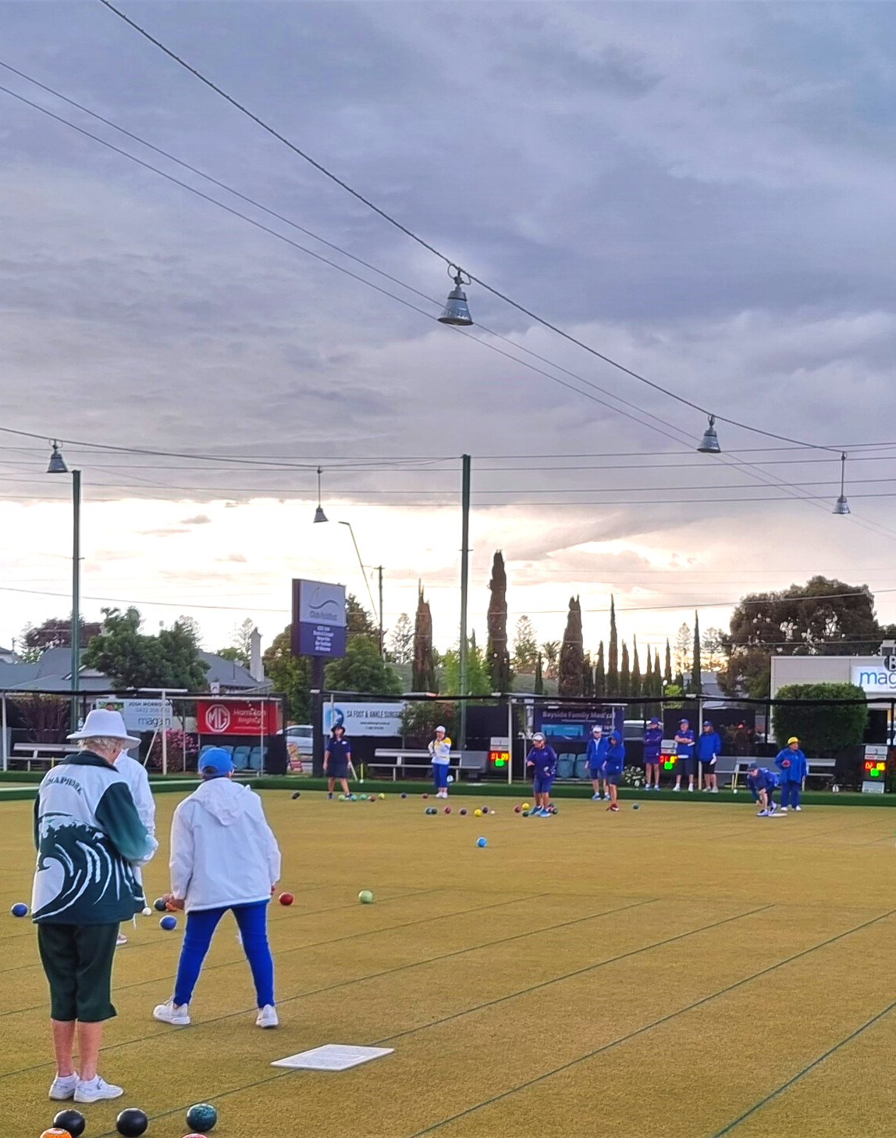

CONTENT
  What is the Registered and Licensed Clubs Award
  Who does it apply to
  IFA’s and Flexible Working Arrangements
  Types of employment
  Classifications
  Hours of Work
  Wages and allowances
  Overtime and penalty rates
  Leave and public holidays
  Consultation and dispute resolution
  Termination and redundancy

Slide 3
Full title - Registered and Licensed Clubs Award 2020 (hereafter referred to as the Clubs Award)
What is the Registered and Licensed Clubs Award
It is one of the Modern Awards which is a document that sets out the minimum terms and conditions on top of the National Employment Standards (NES)
Came into effect on 1 January 2010 and can and have been reviews e.g. 4 yearly review
FWC has ongoing power to review, amend or revoke an award
Temporary provisions were added as a result of COVID-19

Slide 4
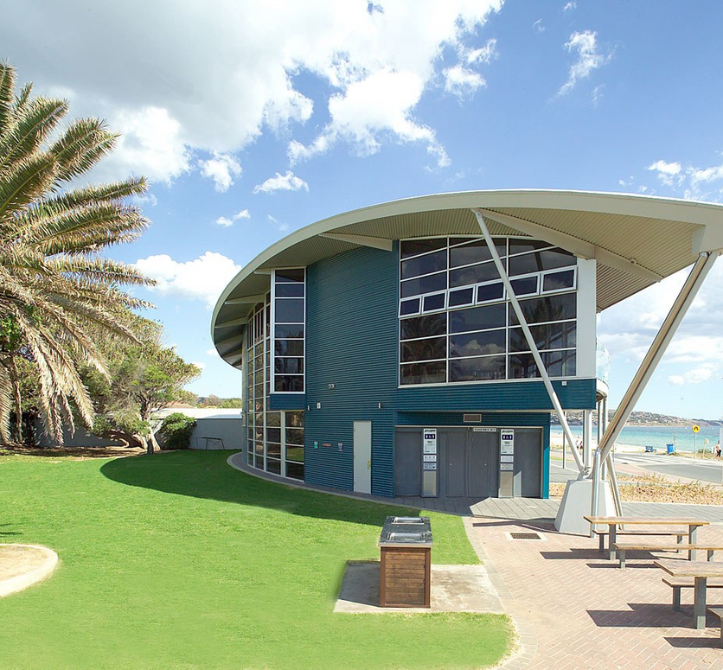
Who does it apply to?
Coverage – Clause 4
The Clubs Award covers employers of employees engaged in the performance of work for or in connection with clubs and their employees themselves in the classifications within Schedule A
Some employees may be covered by an Enterprise Bargaining Agreement (EBA) instead
Some employees may fall outside remit of an award e.g. Marketing Employee
- In that instance it will be the Fair Work Act and NES that covers them

Slide 5
Can agree to alter certain parts of the Award as stated in clause 5.1
An employee must be left better off overall and any agreement needs to be in writing
Individual Flexibility Agreements (IFA’s) & Flexible Working Arrangements
Individual Flexibility Agreements – Clause 5
Requests for Flexible Working Arrangements – Clause 6
Ask for changes to hours, patterns or location of work
Must have been employed for 12 months (casuals – regular & systematic)
Certain types of employees may request flexible working arrangements e.g. people with a disability, someone caring for a child of schooling age etc.
Have to make request in writing and employer must respond (21 days)
Can reject on reasonable business grounds

Slide 6





Types of Employment
Full-time – Clause 9
- Work 38 ordinary hours per week or average of 38 hours over roster cycle
- How hours can be worked set out in clause 15
Part-time – Clause 10
- Must be given guaranteed hours of at least 8 hours a week but less than 38
- Can be rostered any time during agreed availability
- Can’t be rostered for less than 3 hrs or more than 12 hrs in a shift
- Must have at least 2 days off a week
Casual employees – Clause 11
- Work as required but must receive minimum hours per shift (for most this is 2 hrs)
Apprentices – Clause 12
Specific provisions relating to apprenticeships e.g. Training is to be considered as time worked, reimbursement for costs of apprenticeship etc.
Schedule D deals with school based apprentices
Juniors – Clause 13
- No employee under 18 can work more than 10 hours in a shift
- Those engaged in service of alcohol must be paid at adult rate of pay

Slide 7


Classifications
Clause 14 - Classifications
Definitions are all found in Schedule A
As well as being split into different classifications, they also have various grades
Schedule A sets out the typical duties and/or qualifications that someone would have under that classification
Do not need to be doing everything listed in order to fall under one of the classifications/grades and may be possible to do duties across multiple classifications

Slide 8

Hours of Work
Ordinary Hours of Work – Clause 15
Details how f/t employees can work 38 ordinary hours or average of 38 hours a week
Clause 15.6 states when Maintenance and Horticultural employees can work ordinary hours
Clause 15.8 deals with rostered days off for Club Managers (9 days off in a 4 week period)
Rostering Arrangements (F/T & P/T) – Clause 16
Subject to consultation can change with mutual consent at any time or with 7 days notice
Meal Breaks – Clause 17
Generally employees are entitled to unpaid break of at least 30 mins whenever they work more than 5 hours (penalty if not given)
Paid 20 min crib breaks can be used in some circumstances e.g. only employee rostered for duty, less than 10 employees
Maintenance and Horticultural employees get 2 x 10 min paid breaks or one 20 min paid break

Slide 9

Minimum rates - clause 18 (full summary of pays also in Schedule B)
All the ordinary base rates for each classification
Includes ability to pay managers & maintenance & horticultural employees a salary so some award provisions don’t apply
18.5 deals specifically with apprentices and 18.6 with juniors
Management trainees rates found in 18.10, rest found in the Miscellaneous Award 2020
Higher Duties clause 18.11 – 2 hours or more then must be paid higher rate for whole shift
Allowances – Clause 19 (Also summarised in Schedule C)
Additional payments an employee may be entitled to due to doing certain tasks, incurring expenses, using a special skill etc.
Clause 20 states when employees can/have to be paid and Clause 21 deals with Superannuation
Wages and Allowances

Slide 10

Clause 22 – Sets out Overtime rates and TOIL rules
F/T: In excess of 38 hrs a week or outside the spread of hours / rostered hours in the award
P/T: In excess of 38 hrs a week & when work out of rostered hrs (clause 10.13)
Casual: where work in excess of 12 hrs in a shift or 38 hrs in a week / average of 38 hours a week (clause 11.4)
TOIL for overtime only and must be on equivalent basis
Clause 23 deals with situation where manager is recalled for duty
Clause 24 – Sets out Penalty rates
Includes weekend, public holiday and late and early work penalties
Generally not cumulative (exception being penalty where employee is not provided with a meal break)
Overtime and Penalty Rates

Slide 11

Leave and Public Holidays
Leave – Clauses 25 to 30
Public Holidays – Clause 31
A number of leave entitlements just refer to the NES
Annual leave – Clause 25
Excessive leave accrual
Annual leave loading
Annual leave in advance (template – Schedule F)
Rules on cashing out (template – Schedule G)
Clause 29 - Professional development leave (Managers)
Penalty rates for public holidays are in clause 24
As with most types of leave if simply refers to NES
Clause 31.4 – Specific arrangements for F/T employees
F/T employee whose RDO falls on a PH will still receive entitlement of either:
An extra day’s pay;
an alternative day off in 28 days; or
an additional days annual leave
Schedule H specifically deals with part-day public holidays

Slide 12


Consultation and Dispute Resolution
Clause 32 - Must consult about major workplace change
Must consult over matters such as:
Termination of employment
Redundancies
Alteration of hours of work
Retraining and transfer of work to other locations
Clause 33 - Must consult about changes to rosters or hours of work
Does not apply to employees whose hours are sporadic, irregular or unpredictable e.g. a casual
Clause 34 - Dispute Resolution
Generally states that where there is a dispute about something in the Award an employee and management need to firstly try and resolve the issue in a timely manner.
If the above does not work then a party can refer the matter to the Fair Work Commission

Slide 13
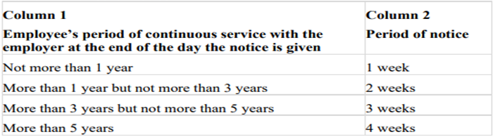
Clause 35 - Termination
Sets out notice required by employee
Notice required mirrors what an employer has to give under the Fair Work Act (minus extra week for over 45 yr olds)
If employee gives insufficient notice - can deduct up to a weeks worth of pay at the award rate (must be over 18 and reasonable to do however)
Notice of Termination & Redundancy
Clause 36 - Redundancy
Sets out need to give notice should an employee be transferred to a lower paid position
Clause 37 – Accommodation - Managers
Allows agreement for accommodation costs to be deducted from managers pay

Slide 14
Rhys Braybrook
Workplace Relations & Policy Manager
PHONE NUMBER
THANK YOU
0448 273 355
E-MAIL ADDRESS
workplacerelations@clubssa.com.au

